Slide 1
Final Project Proposal
Galen Sipes

Slide 2
Idea
Take the solar system assignment and make it interactive
Make it 3D
Project images of the actual planets onto the surface

Slide 3
Why?
I like space and the solar system assignment was fun
I want to learn more about input events, interactions, and texturing objects.
I want to make an interesting solar system to show off my programming skills.

Slide 4
Does it solve a problem?
It helps me better understand texturing
Could potentially be used for education purposes for kids.

Slide 5
How it would look
Similar to solar system assignment, but 3D instead of 2D.
Sun in the middle of the screen
Planets rotate around the sun at set distances.
You can zoom in and out of the system

Slide 6
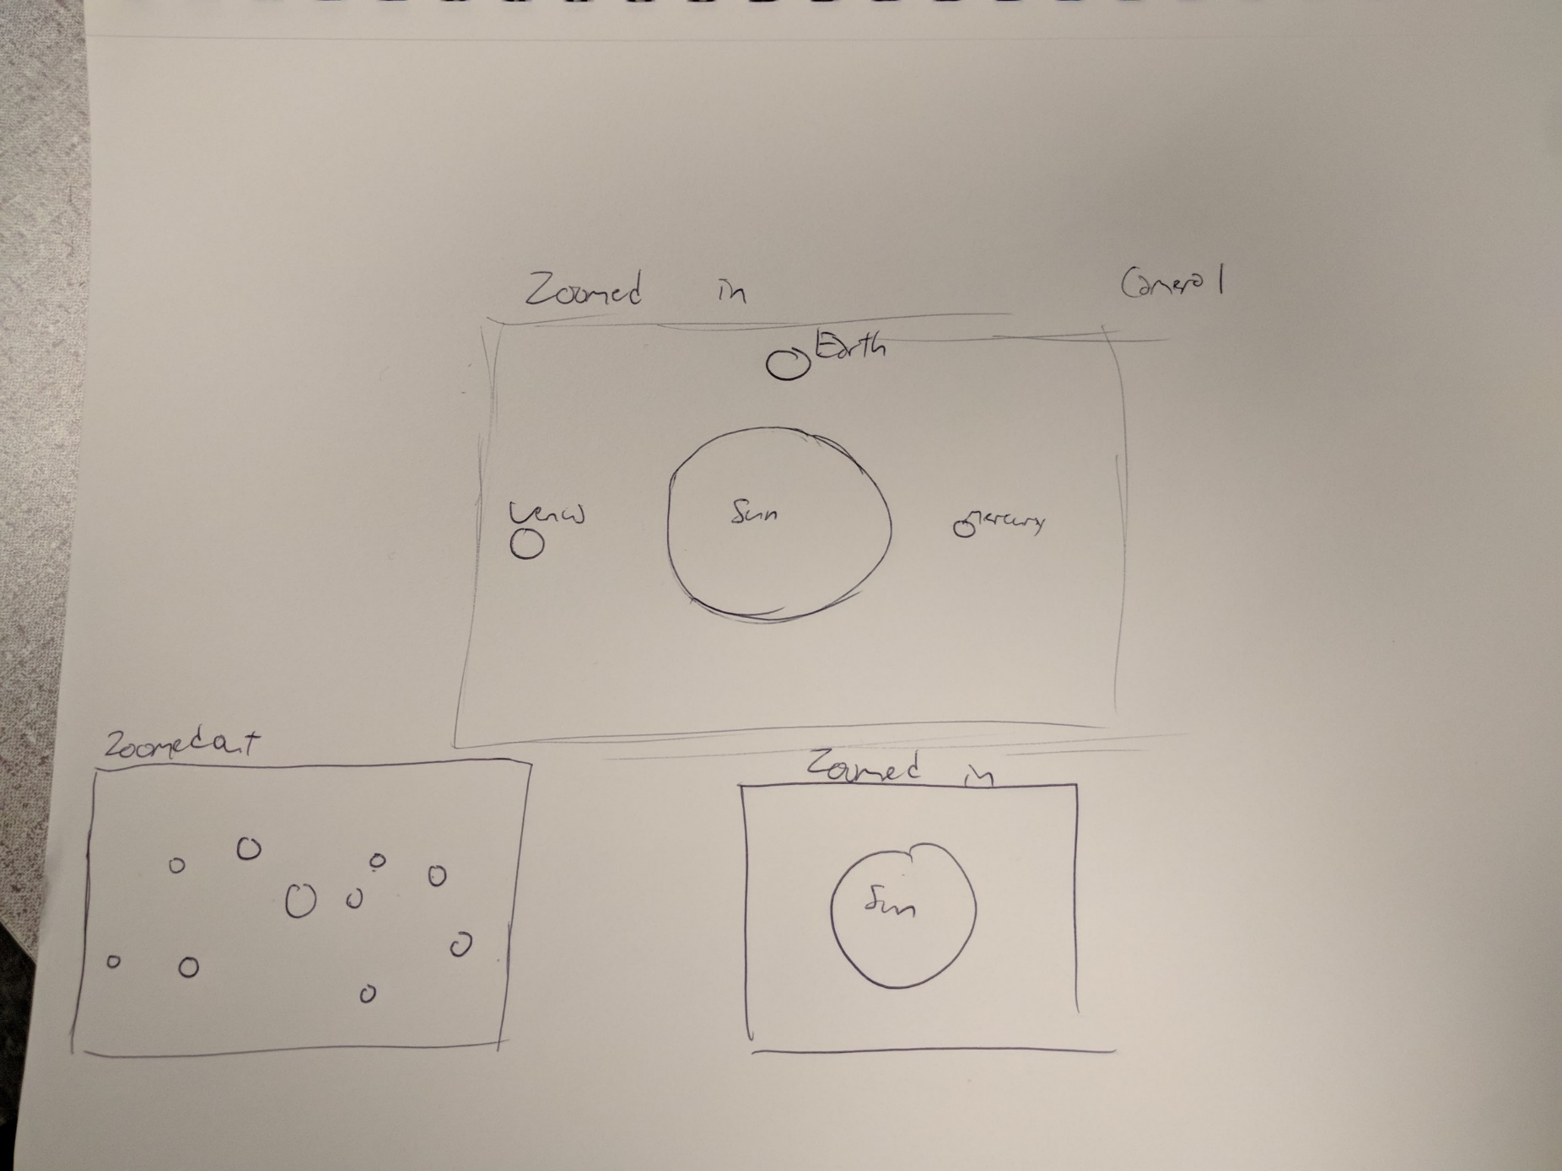

Slide 7
Technical Part: Texture mapping a sphere
Will research how to texture map basic objects
Move on to spheres, then multiple spheres
Will use NASA texture images for mapping
Will need to learn zooming the screen, rotating screen using mouse.

